Slide 1
Book2
File created on: 08-11-2019 03:59:52

Slide 2
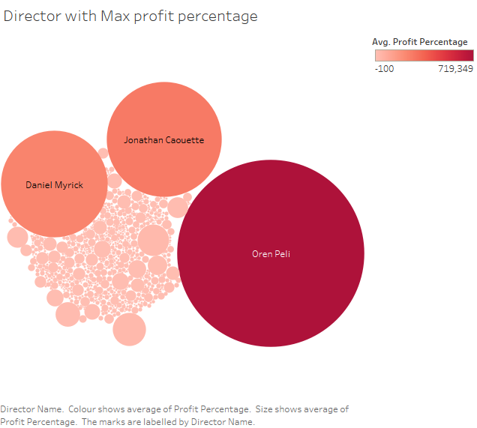

Slide 3
